Slide 1
Analyzing Housing
Market in Chicago
Chicago | December 11, 2020

Slide 2
Agenda
Solutions
Future steps
Intro and Objective
Modeling and Results

Slide 3
Introduction
Objective
Audience
Value

Slide 4
Chicago vs US cities
Why is Chicago unique?
What is behind?
What else?
Notes:
https://www.cnn.com/2020/07/28/business/starbucks-earnings-coronavirus/index.html

Slide 5
Data sources
Zillow (primary)
2008 – 2020 (tbd)
150+ data points only (months)
Average mortgage rate
Monthly
CPI?
Notes:
https://www.cnn.com/2020/07/28/business/starbucks-earnings-coronavirus/index.html

Slide 6
Data quality
No missing data
Average mortgage rate
Monthly
CPI?
Notes:
https://www.cnn.com/2020/07/28/business/starbucks-earnings-coronavirus/index.html

Slide 7
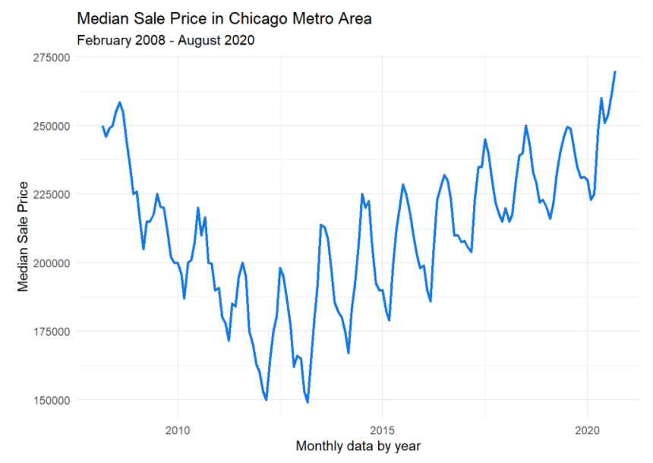

Slide 8
Exploratory data analysis
Non-stationary
Unusual high seasonality
Two trends – down and up
The same magnitude
Notes:
https://www.cnn.com/2020/07/28/business/starbucks-earnings-coronavirus/index.html

Slide 9
ACF & PACF
Notes:
https://www.cnn.com/2020/07/28/business/starbucks-earnings-coronavirus/index.html

Slide 10
Initial model selection (why?)
ARIMA/sARIMA
Exponential Smoothing
VAR model
Regression with ARMA errors?
Prophet?
Notes:
https://www.cnn.com/2020/07/28/business/starbucks-earnings-coronavirus/index.html

Slide 11
Initial model selection (why?)
ARIMA/sARIMA
Exponential Smoothing
VAR model
Regression with ARMA errors?
Prophet?
Notes:
https://www.cnn.com/2020/07/28/business/starbucks-earnings-coronavirus/index.html

Slide 12
Models (from worst to best) and results
Notes:
https://www.cnn.com/2020/07/28/business/starbucks-earnings-coronavirus/index.html

Slide 13
Next steps
Notes:
https://www.cnn.com/2020/07/28/business/starbucks-earnings-coronavirus/index.html

Slide 14
Sources
GitHub repository

Slide 15




Our Team
Chris Reimann
Kyla Ronellenfitsch​
Oleksiy Anokhin​
Mike Thompson

Slide 16
Q & A

